Slide 1
D BALAKUMAR
412721205005
TAGORE ENGINEERING COLLEGE
1

Slide 2
PROJECT TITLE
EMOTION DETECTION USING THE CNN ALGORITHM
3/21/2024 Annual Review

Slide 3


AGENDA
Motive of this project is to analyze the emotion of the person by giving the picture input to the model ,and it helps the psychological experts to study the human emotional behavior.
This improves the handling of students by the teachers easily.
It helps the animator to design the movie characters using the emotions.
Emotion detection enhances user experiences by adapting content based on emotions in the virtual gaming.
3/21/2024 Annual Review

Slide 4

PROBLEM STATEMENT
Develop a Convolutional Neural Network (CNN) model for emotion detection from facial images. The goal is to accurately classify the emotions depicted in facial images into one of several predefined categories, such as happiness, sadness, anger, fear, surprise, or neutral.
Emotion detection is a crucial component in various applications, including human-computer interaction, mental health monitoring, and sentiment analysis in social media.

Slide 5

PROJECT OVERVIEW
The project aims to develop an emotion detection system using Convolutional Neural Networks (CNNs) to accurately classify emotions depicted in facial images.
This system will find applications in various domains including human-computer interaction, mental health monitoring, and sentiment analysis in social media.
It aims to give the accurate results for users.

Slide 6

WHO ARE THE END USERS?
Software Developers and Engineers
Researchers and Data Scientists
Psychologists and Mental Health Professionals
Educators and Trainers
Human-Computer Interaction (HCI) Designers
Marketing and Advertising Professionals
3/21/2024 Annual Review

Slide 7

YOUR SOLUTION AND ITS VALUE PROPOSITION
The project solution involves developing a robust emotion detection system using Convolutional Neural Networks (CNNs) to accurately classify emotions depicted in facial images.
Accurate Emotion Recognition
Enhanced Human-Computer Interaction
Mental Health Monitoring
Improved Marketing and Advertising
Security and Surveillance

Slide 8

THE WOW IN YOUR SOLUTION
This model can give the Accurate Emotion Recognition ,and it can be implemented in the real world.
It can be used in the health monitoring, research, security ,and surveillance.
The iterative nature of the solution, involving performance tuning and iteration based on feedback and real-world usage, ensures that the emotion detection system can continuously improve and adapt to evolving requirements, user feedback, and changes in data distribution. This commitment to ongoing improvement enhances the long-term viability and effectiveness of the solution.
3/21/2024 Annual Review

Slide 9
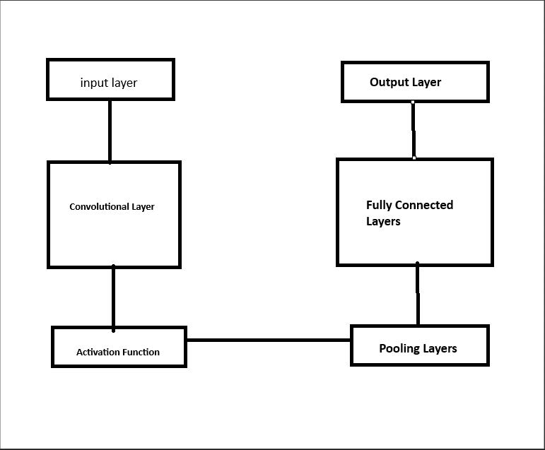
MODELLING
Process of AI model

Slide 10
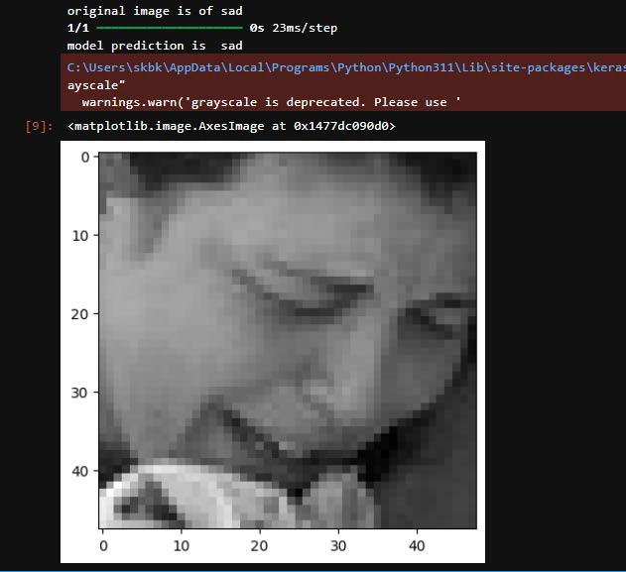
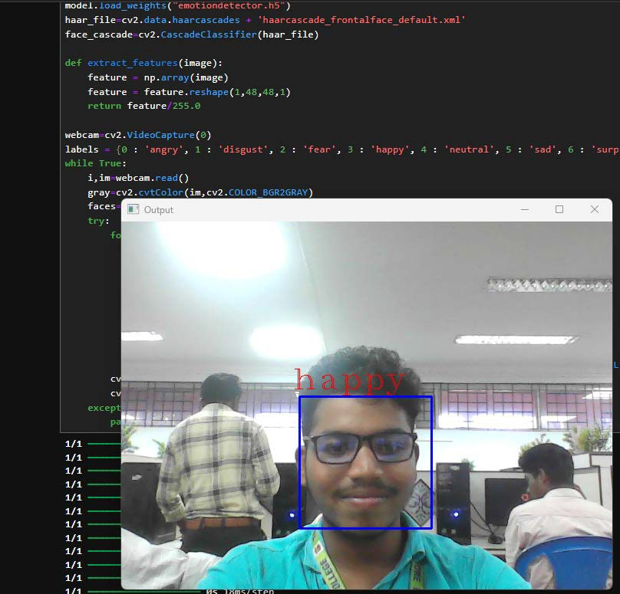
RESULTS

